Slide 1
What's the Future Of Human-Computer Interaction (HCI)?

Slide 2
What if user interfaces were no longer trapped within a screen and were instead integrated into your everyday life?
Imagine a future where interfaces are personalized to your needs and can appear anywhere. A future where you actually converse with computers rather than poking letters on a screen.

Slide 3
Human-Computer Interaction: Where we are now

Slide 4
There’s no doubt that the way we interact with computers has changed drastically over the last decade. And if you’re thinking about becoming a UI designer you’re probably especially aware how much smartphones and tablets have paved the way for tons of new and unique interactions between humans and computers.

Slide 5
These portable devices have enabled all sorts of amazing new human-computer interactions, all in the palm of your hand. Voice is another type of interaction that is on the rise.
Programs like Apple’s Siri are making it possible to set appointments, search the internet, set timers and other simple tasks using only your voice. The potential of this type of human-computer interaction is absolutely huge, but we’ve still got a long way to go.
We’re also on the cusp of some amazing advancements in VR. The Oculus Rift, which first came on the scene in 2012, has promised the first truly immersive virtual reality experience in a headset.

Slide 6
Wearables have been coming into the spotlight as well. I can’t even count the amount of exercise wristbands on the market. And, with the Apple Watch coming onto the scene, competition is bound to start heating up as these devices become smaller, more featured and more stylish.

Slide 7
What the future holds

Slide 8
Voice-Guided User Interfaces

Slide 9
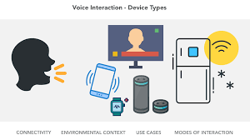

Slide 10
Voice interaction is going to go way beyond setting appointments and surfing the web. It’s predicted that, in the next 5 years, adoption rate of speech recognition will be over 80%. This makes a lot of sense when you consider how much smaller our screens are getting.
With less screen real-estate, interfaces will become much harder to navigate. Touch will likely still be king on mobile for a long time to come, however, voice certainly promises a deeper and more ubiquitous method for interacting with our devices. As a UI designer, the key here will be staying up to date with new voice-guided apps and technologies as they enter the market.

Slide 11
Virtual/Augmented Reality

Slide 12
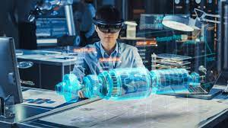

Slide 13
This new technology will come with a completely new set of human-computer interactions. These new VR technologies will give rise to so many new and unique interactions, it will truly change the way we design user interfaces and interact with computer systems. Interfaces will no longer be trapped in tiny screens but will instead inhabit our own three dimensional world. In fact, the job of the interface designer and the 3D computer animator will begin to blur together.
The transition will be gradual, but it will be extremely important for UI and UX designers to become familiar with 3D design techniques if they are going to stay relevant in this new VR driven world.

Slide 14
Wearables

Slide 15
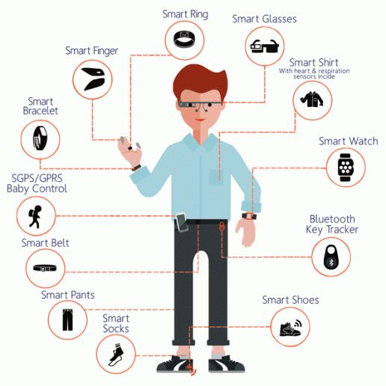

Slide 16
Eventually we will be able to inject this technology directly into our bodies. This means you’ll be able to monitor your most important vital signs without any hardware at all. And just think of all the data. You’ll literally have a consistent and accurate record of all of your vital signs thought your life! The benefits to human health alone could be huge.
But, if this sort of future sends chills down your spine, rest assured that it’s still a long way off. But it is coming. For now, the wearables market is slowly gaining momentum and there are a lot of new interactions and design patterns that will come from that. So, for now, why not try your hand at designing some cool Apple watch interfaces!

Slide 17
Final thoughts

Slide 18
In fact, they are laying the foundation for a future where humans and computers are tied more closely together than ever before. For designers, it’ll be super important to keep a close eye on these markets as they develop. Things are certainly going to be changing big time, but the good news is these big changes won’t come overnight.
But that doesn’t mean designers can rest on their laurels! Stay on top of new design trends in these sectors and don’t be afraid to dive in and start working with these new computer systems and design patterns. It’s the best way to future proof yourself for this new coming world.

Slide 19
The Past

Slide 20
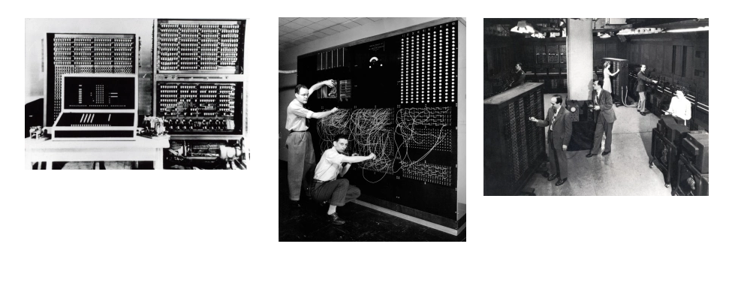

Slide 21
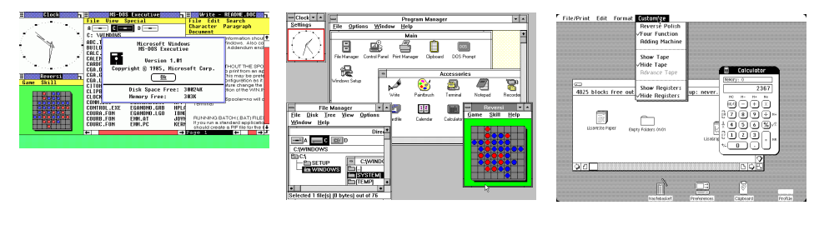

Slide 22
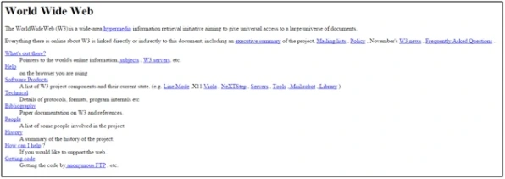
Another notable HCI history, in the past, is invention of World Wide Web (WWW). On 6 August 1991, first web debut was created by Tim Berners-Lee. Berners-Lee publish short summary of WWW project, and available for users after 23 August

